Slide 1
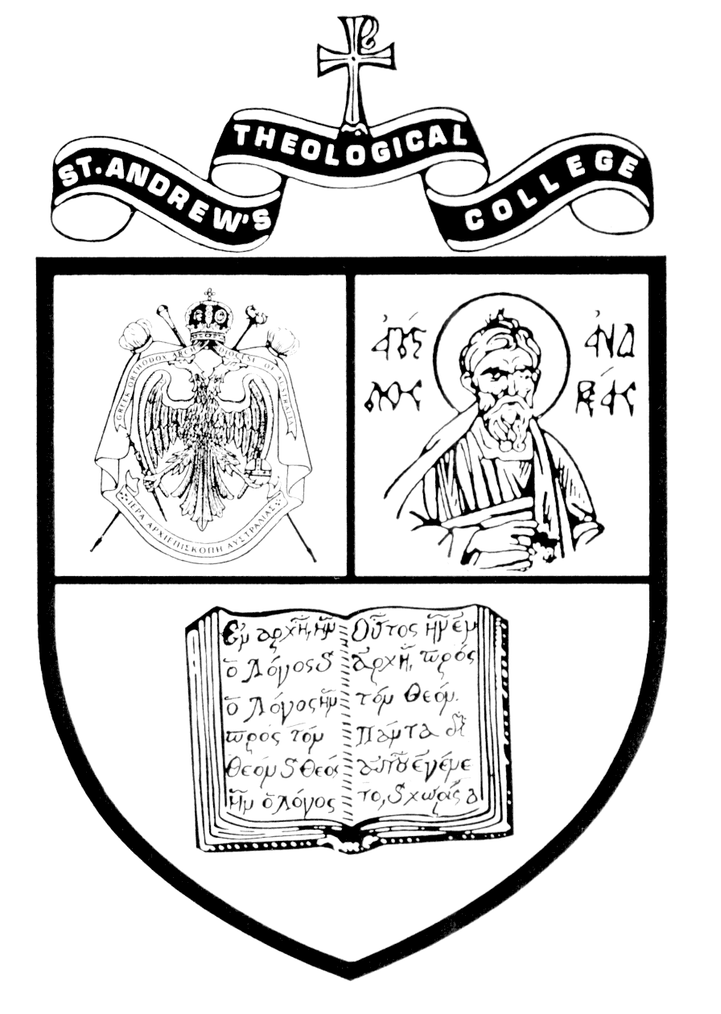
Insights into the Study of the Church Fathers
St Andrew’s Greek Orthodox Theological College
Autumn Residential School
18-20 April 2012
Revd Dr Doru Costache
Senior Lecturer in Patristics

Slide 2
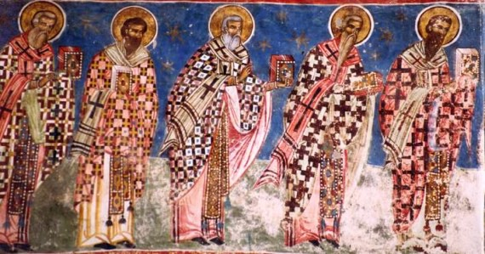
The Church Fathers
Humor Monastery, Romania, 1530

Slide 3
Studying the Fathers at St Andrew’s
The scholarly component: analysis of the primary and secondary literature
The ecclesial component: interpretation of the available information within the parameters of Church’s mindset and life
Practical application: for example, the assessment criteria refer to scholarly standards and ecclesial awareness alike
Paraphrasing and reversing Einstein’s famous saying (“science without religion is lame, religion without science is blind”), my conviction is that scholarship without ecclesial insight is blind whereas the ecclesial vision without scholarship is lame.

Slide 4
Studying the Fathers at St Andrew’s
Transformation
Formation
Information

Slide 5
Studying the Fathers at St Andrew’s
The ecclesial component:
Application of a dogma (opinion, vision) relevant to God’s people, in the interpretation of the analysed data
Concern of the interpretive process with formative and transformative goals

Slide 6
Studying the Fathers at St Andrew’s
The secret ingredient: we treat the Church Fathers as saints and spiritual guides, and not only as writers ➔ their teaching is relevant to the spiritual journey irrespective of time and space

Slide 7
Studying the Fathers at St Andrew’s
Another secret of our approach: we do not believe in a closed patristic age
Panayotis Chrestou, Greek Orthodox Patrology (Rollingsford 1995), 15-16: “The Church has never excluded the appearance of renowned teachers in her bosom, who are outstanding bearers of the divine grace of the divine spirit, and she has never restricted this appearance to any particular period of her history. Orthodox ecclesiastical consciousness, which attributes the title of father in every epoch to elect vessels of grace that lived in previous epochs, has already pushed the patristic period to the end of the Byzantine era and is pushing forward beyond it more and more. This does not exclude the habit of regarding the fathers of the first Christian centuries, when the foundation of the Christian institutions were first laid and the dogmatic teaching was specified to a large extent, as occupying a privileged position.”

Slide 8
Three Examples
“Our blessed and holy father Symeon […] endured […] great trials and temptations […]. This is why he was glorified by God so that he became dispassionate and saint, receiving within himself the whole, so to speak, Paraclete. Then, just as a father freely gives his son a share, so he bestowed on me, his unworthy servant, freely, without effort on my part, the Holy Spirit.” (St Symeon the New Theologian, Catechetical Discourses 6.10)

Slide 9
Three Examples
“the novice naturally needs a guide, for until the advent of the grace of the Holy Spirit the soul is involved in fierce struggle against her foes, and is unable to disentangle herself if the enemy offers her his delights. Only the man with experience of the grace of the Holy Spirit can understand this. He who has savoured the Holy Spirit recognises the taste of grace.” (St Silouan the Athonite, Diary, On prayer)

Slide 10
Three Examples
“I strongly witness the work of the Providence accomplished within me, and which is unceasingly accomplished in me. I witness again the wholeness of divine mercies poured upon us and those which will be elected by the Lord, in incomprehensible ways and in such different modes, as tools of the glory of his holy Name. […] Since my very youth, the sweet energy of the Providence rested its favour into my heart and, on the way of my salvation, granted me the graceful blessing of the Inheritance. It granted me also a spiritual father into whom the grace that filled his life was working. Likewise, and moreover, it granted me, along my journey, the unmediated grace of strength and wisdom.” (Fr John the Stranger, Letter to his disciples; my translation from Romanian)

Slide 11
Studying the Fathers at St Andrew’s
An intellectual challenge
A culturally enriching endeavour
A life-changing experience

